Slide 1


SHIELD INSURANCE
Presented by – Ankit Kumar

Slide 2

GENERAL INFORMATION
The main objective of this project is to conduct a thorough analysis of the business, focusing on customer base, revenue generation, growth rates, policy changes, settlement and demographics. This aims to provide valuable insights for informed decision-making.
The Report is in 3 different parts :
General View: Consolidated Report Summary
Sales View : Contains Sales Performance
Age Segment : Age - Wise Sales Performance

Slide 3

GENERAL INFORMATION
ABOUT COMPANY
Shield Insurance is renowned for offering comprehensive insurance solutions that safeguard individuals against life's unforeseen events. Their reputation for reliability is built on a steadfast commitment to delivering dependable coverage.

Slide 4
GENERAL INFORMATION
ABOUT COMPANY
Sales Mode
Online – Website and App
Offline – Agent and Direct
Shield Insurance provides a total of 9 policies in 5 different cities
Delhi NCR
Indore
Mumbai
Hyderabad
Chennai

Slide 5
GENERAL INFORMATION
DATASET
Dim_customer
Dim_policies
Dim_date
Fact_premium
Fact_settlement
Data Timeline : From Nov 1st 2022 to Apr 31 2023.

Slide 6
LETS EXPLORE DASHBOARD

Slide 7
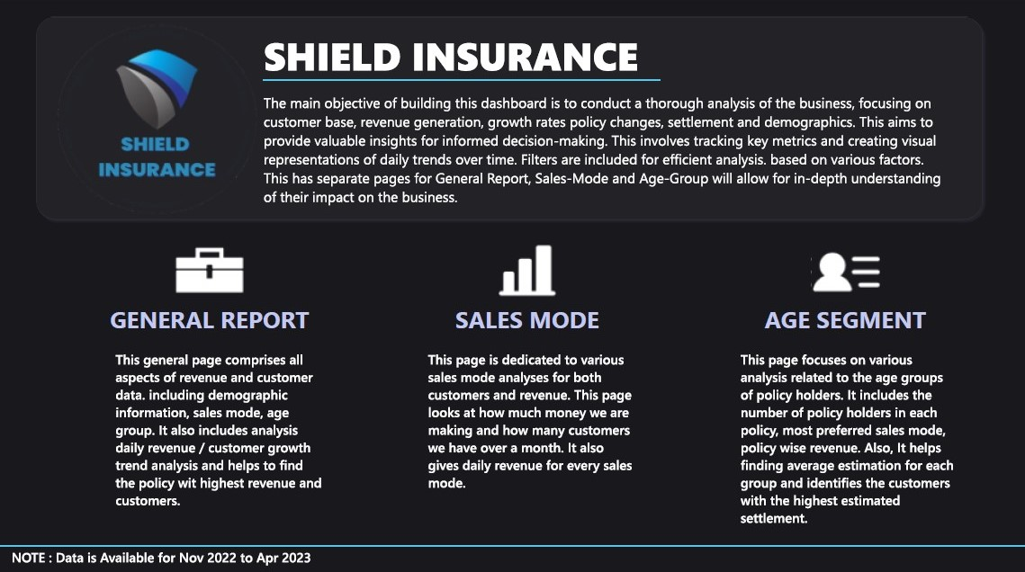

Slide 8
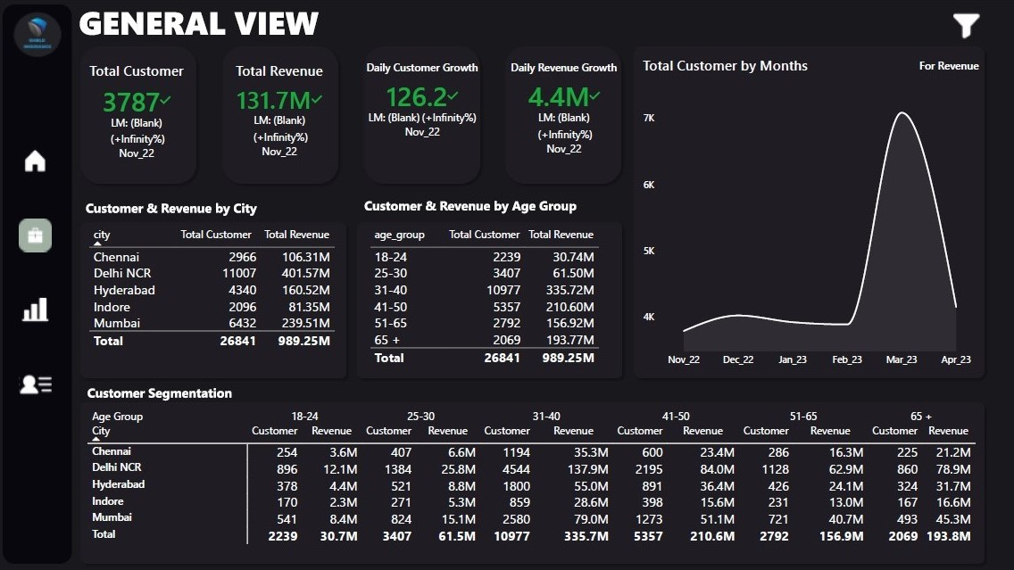

Slide 9
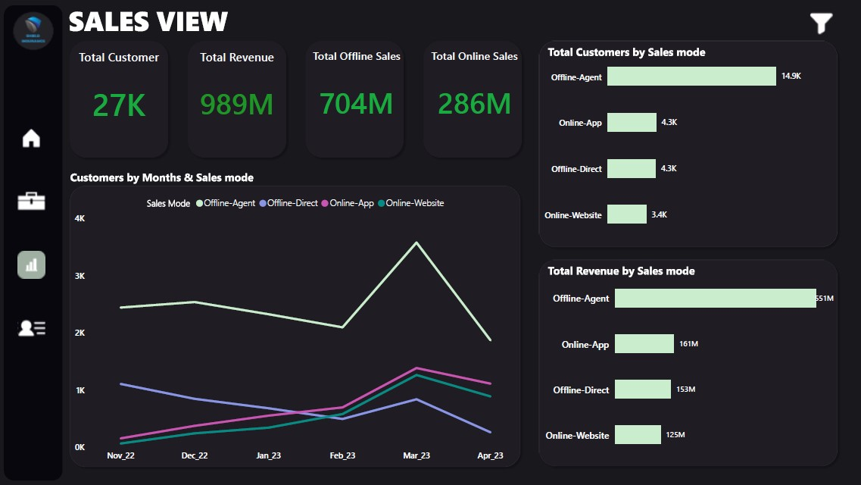

Slide 10
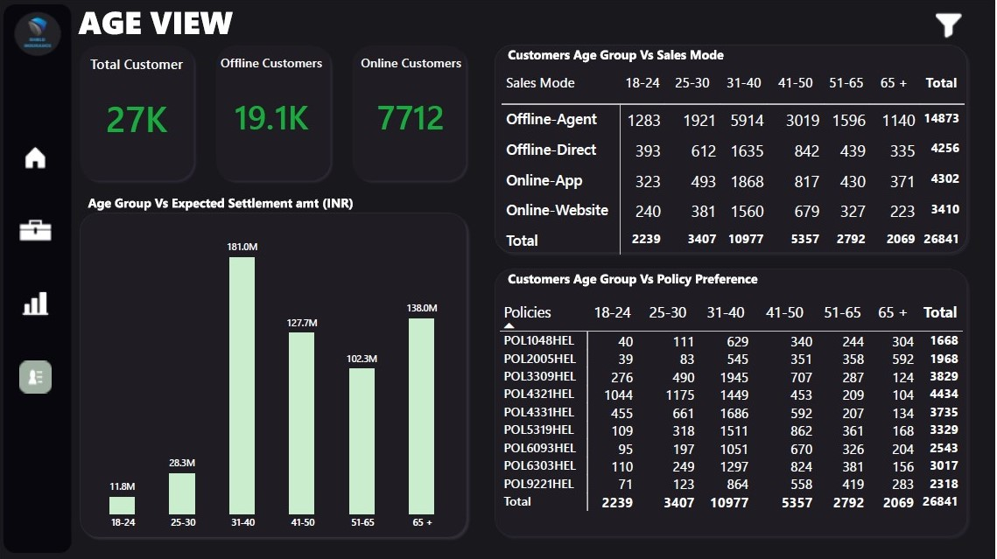

Slide 11
GENERAL FINDINGS
KPI’s
Total Revenue : 989.25 M
Total Customers : 26841
Daily Average Customer Growth : 148(Approx)
Date & Months :
Date with Highest Revenue(16.79 M) and Highest Customers(418) acquired is: 25 March 2023
Date with Lowest Revenue(2.05 M) and Customers (71) acquired is: 17 Nov 2022.
Month with Highest Revenue(264 M) and Highest Customers(7081) acquired is: March 2023
Month with lowest Revenue(131.7 M) and lowest Customers(3787) acquired is: Nov 2022
March is the busiest month in the company, most people buy policies in the month of March to qualify for the Tax Exemption as March is the last month of Indian Financial Year.

Slide 12
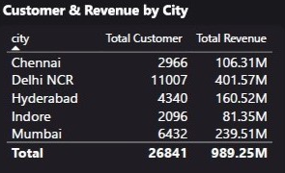
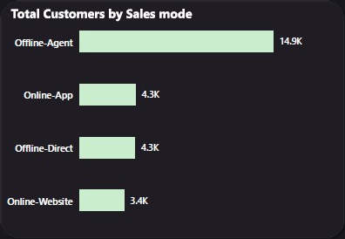
GENERAL FINDINGS
KPI’s
Total Revenue : 989.25 M
Total Customers : 26841
Daily Average Customer Growth : 148(Approx)
Date & Months :
Date with Highest Revenue(16.79 M) and Highest Customers(418) acquired is: 25 March 2023
Date with Lowest Revenue(2.05 M) and Customers (71) acquired is: 17 Nov 2022.
Month with Highest Revenue(264 M) and Highest Customers(7081) acquired is: March 2023
Month with lowest Revenue(131.7 M) and lowest Customers(3787) acquired is: Nov 2022
March is the busiest month in the company, most people buy policies in the month of March to qualify for the Tax Exemption as March is the last month of Indian Financial Year.

Slide 13
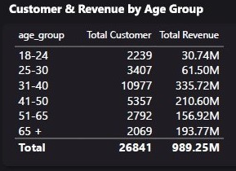
GENERAL FINDINGS
City
City which Acquired Highest Total Revenue and acquired highest number of customers: Delhi NCR
City which acquired lowest Total Revenue and acquired lowest number of customers: Indore
Sales Mode :
Most preferred sales mode by Customers(55%): Offline-Agent
Least preferred sales mode(12%) : Online-Website

Slide 14
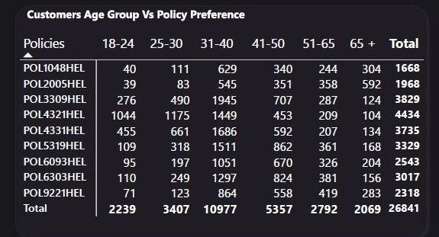
GENERAL FINDINGS
Age Segment :
Age Segment with highest Revenue and customer acquisition is: 31-40
Age Segment with lowest Revenue acquisition is: 18-24
Age Segment with lowest Customer acquisition is: 65+
18-24 segment receives highest Revenue (7.5 M) in the month of Jan whereas all other age segment gained their peak in March.

Slide 15
GENERAL FINDINGS
Policy Preference :
Policy with highest Revenue Acquisition (324M): POL2005HEL
Policy with highest Customer Acquisition (4434): POL4321HEL

Slide 16
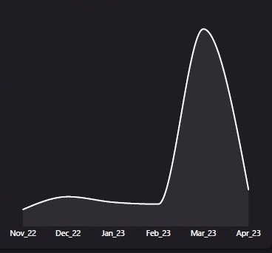
INSIGHTS
Why old people buy costly policies ?
The data suggests that old people buy policies with costly premiums. Like, 577 senior citizens, which is a predominant headcount, buy POL2005HEL with premium of 120K. It’s because in old age most of the people came up with pre-existing diseases and are more likely to require frequent medical care, insurance companies usually charge a higher premium to cover them.
So, it’s quite normal to say that most of the people don’t even buy the policies.
To answer this problem, company can analyze health risks in the 65+ age group and adjust premiums accordingly to accurately reflect potential claims costs.

Slide 17
INSIGHTS
Why march is the busiest month ?
March is crucial in India's financial calendar, particularly for insurance purchases, driven by tax-saving motives. As the fiscal year ends, individuals rush to optimize tax liabilities, favoring insurance policies for their tax benefits. Strategic purchases, aided by tailored offerings and promotions, dominate this period. Additionally, the need for year-end tax declarations accelerates policy acquisitions. In essence, March represents a vital window for insurance investments in India.
An insurance company can capitalize on other months also by:
Offering tax-saving insurance products.
Providing incentives for March purchases.
Training agents on tax-saving policies.
Utilizing digital channels for promotions.
Streamlining processes for efficiency.

Slide 18

THANK YOU
Do you have any questions ?
Feel free to ask anything….
Presented by : Ankit Kumar

